Slide 1
Joint Charlotte-Punta Gorda MPO and Lee County MPO Board Meeting
February 17, 2023

Slide 2
TRIP Priorities

Slide 3
2023 JOINT TRIP PRIORITIES FOR LEE AND CHARLOTTE COUNTY-PUNTA GORDA MPO
Adoption by Lee MPO in May or June
Adoption by Charlotte County-Punta Gorda MPO in May 2023
Sponsor | Route | From | To | Proposed Improvement | Requested Phase | Total Cost | Requested TRIP Funds | Amount of TRIP Funds Prgrammed | Year Funded | 2023 Joint Priority
Lee County | Burnt Store Rd | Van Buren Pkwy | ~1000' North of Charlotte Co/L | 2L to 4L | ROW | $32,000,000 | $4,000,000
Charlotte County | Harborview RD | Melbourne St | I-75 | 2L to 4L | CST | $45,630,000 | $4,000,000 | TBD | 2025/2026
Lee County | Corkscrew Road | E. Ben Hil Griffin Road | Bella Terra | 2L to 4L | CST | $24,525,000 | $6,975,000 | $2,651,966 | 2021/2022
Charlotte County | Edgewater Dr/Flamingo Blvd Ext. | Midway Blvd | Collingswood Blvd | 2L to 4L | PE, CST | $38,080,000 | $2,200,000
Lee County | Ortiz Avenue | Colonial Blvd | SR 82 | 2L to 4L | CST | $16,520,000 | $4,000,000
Charlotte County | Jones loop Rd | Burnt Store Rd | Piper Rd | 4L to 6L | PE, CST | $45,020,000 | TBD
Lee County | Corkscrew Road | Bella Terra | Alico Road | 2L to 4L | CST | $16,068,000 | $4,000,000
Charlotte County | Kings Hwy | Sandhill Blvd | DeSoto County Line | 2L to 4L | CST |  | $5,000,000
Lee County | Three Oaks Pkwy Ext. | Fiddlesticks Canal | Pony Drive | New 4L | CST | $60,774,000 | $8,000,000
Lee County | Three Oaks Pkwy | Pony Drive | Daniels Parkway | New 4L | CST | $31,720,000 | $7,500,000
Lee County | Ortiz Avenue | SR 82 | Luckett Road | 2L to 4L | CST | $28,475,000 | $5,000,000
Lee County | Alico Extension - Phase I | Airport Haul Rd | East of Alico Road | 2L to 4L/New 4L | CST | $10,759,000 | $3,000,000
Lee County | Alico Extension - Phase II & III | East of Alico Rd | SR 82 | New 4L | CST | $95,781,000 | $8,000,000
Lee County | Ortiz Avenue | Luckett Road | SR 80 | 2L to 4L | CST | $28,418,000 | $5,000,000

Slide 4
Charlotte County Economic Development Overview

Slide 6
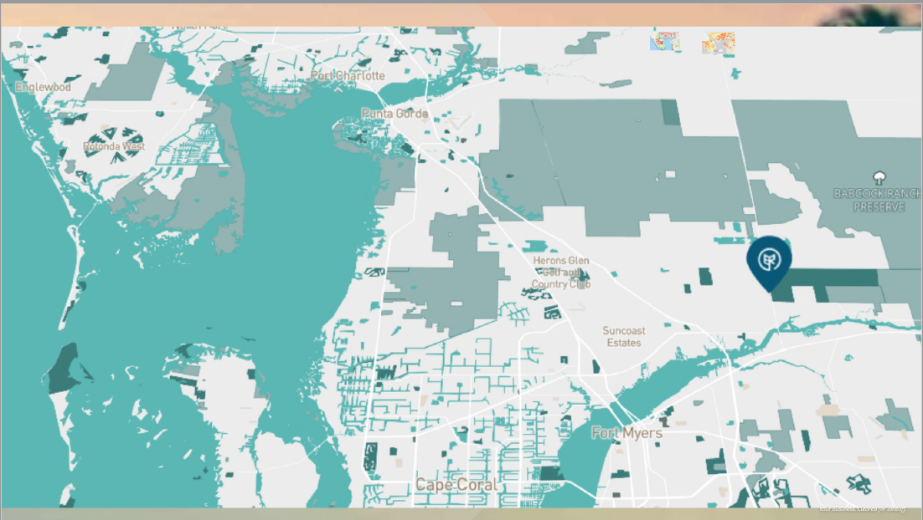

Slide 7
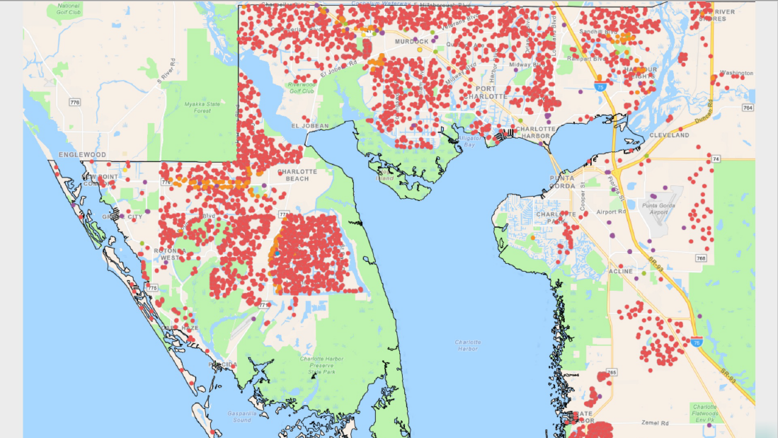

Slide 8
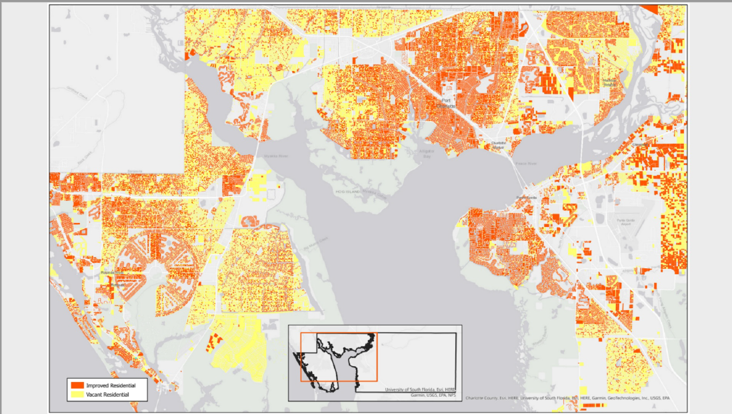

Slide 10
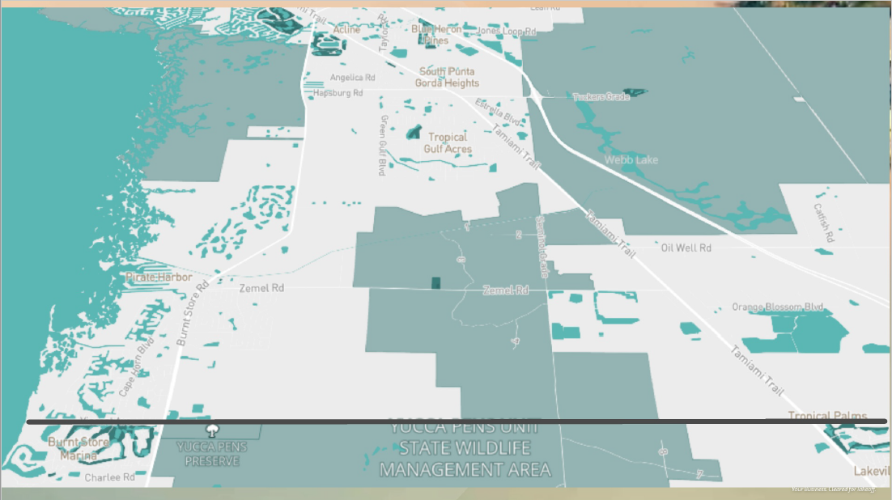

Slide 13
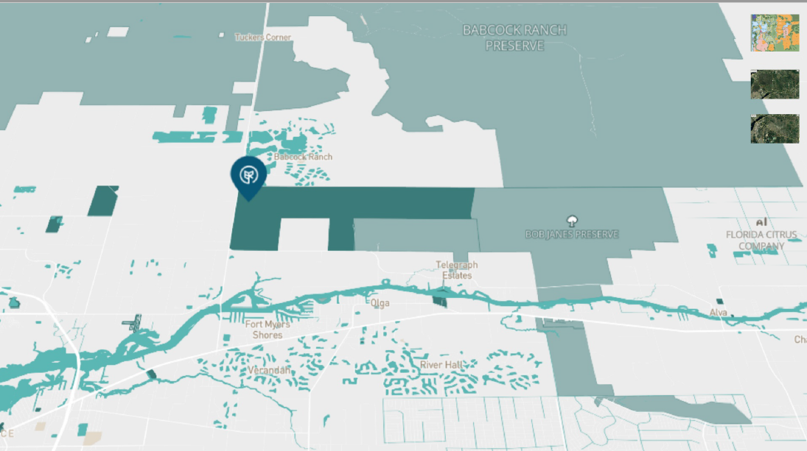

Slide 14
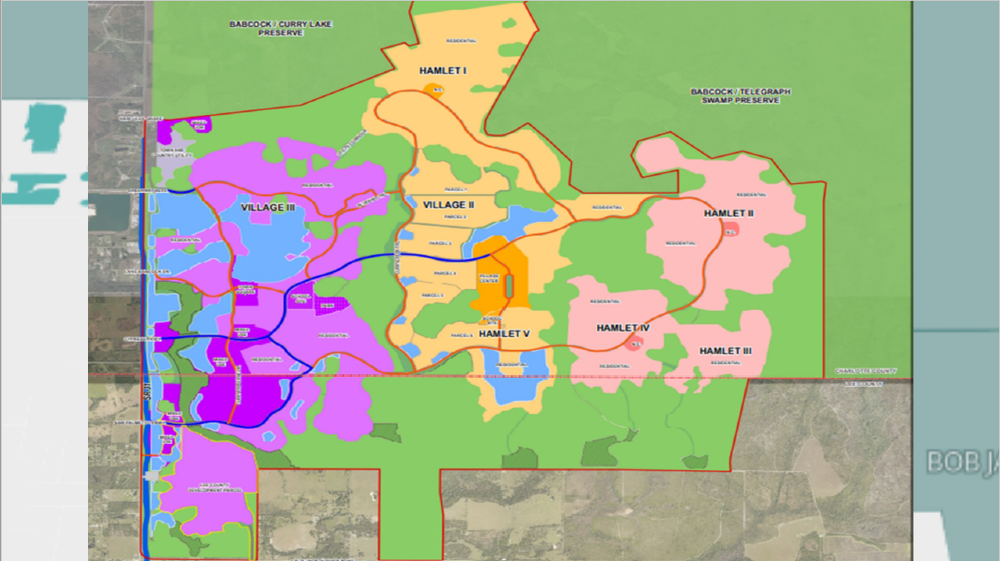

Slide 15
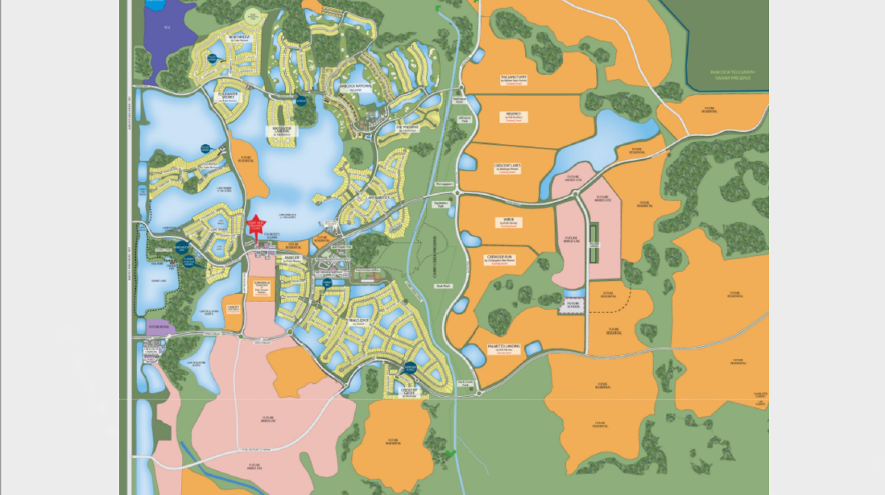

Slide 16
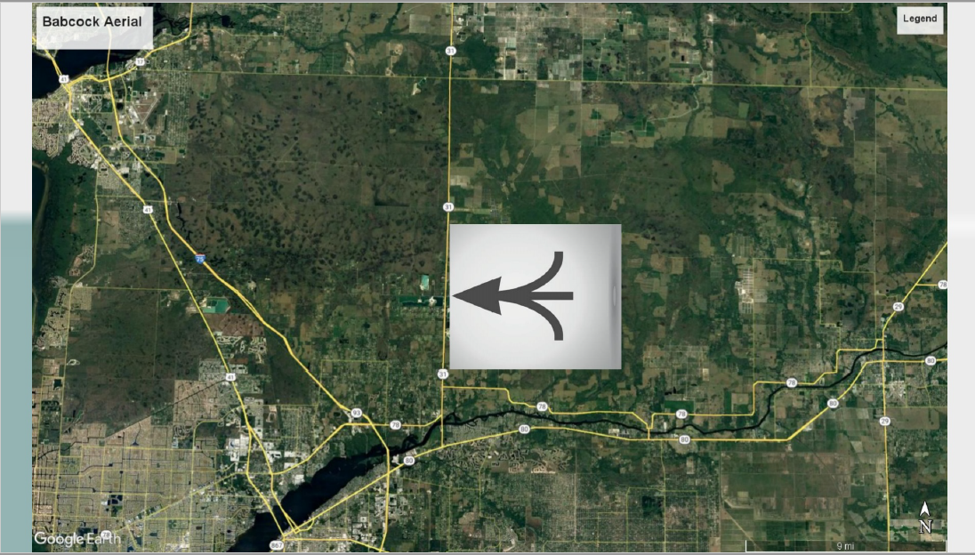

Slide 17
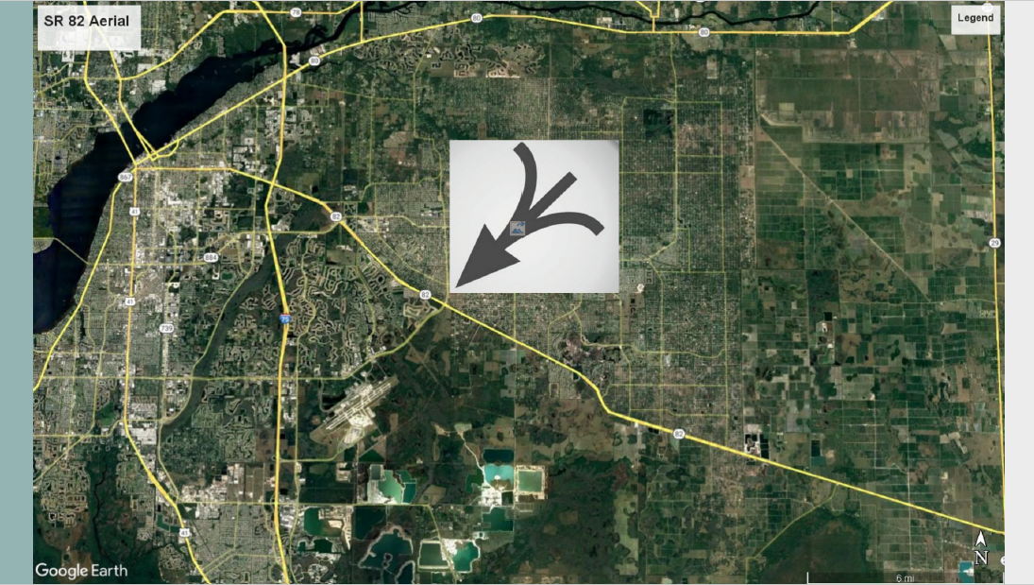

Slide 19
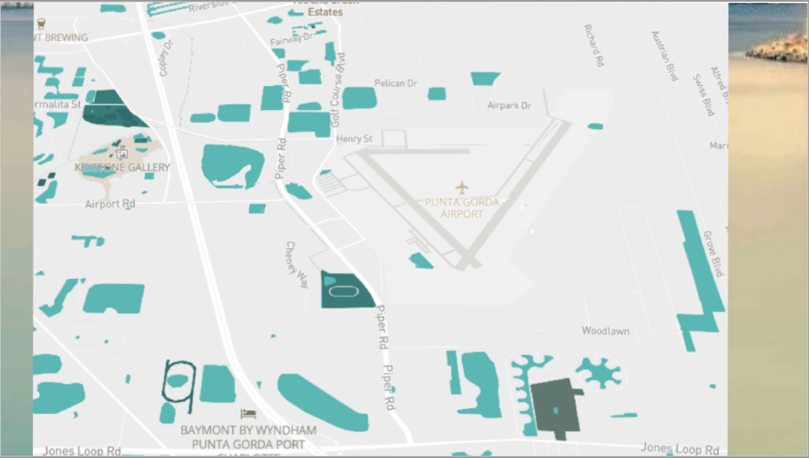

Slide 20
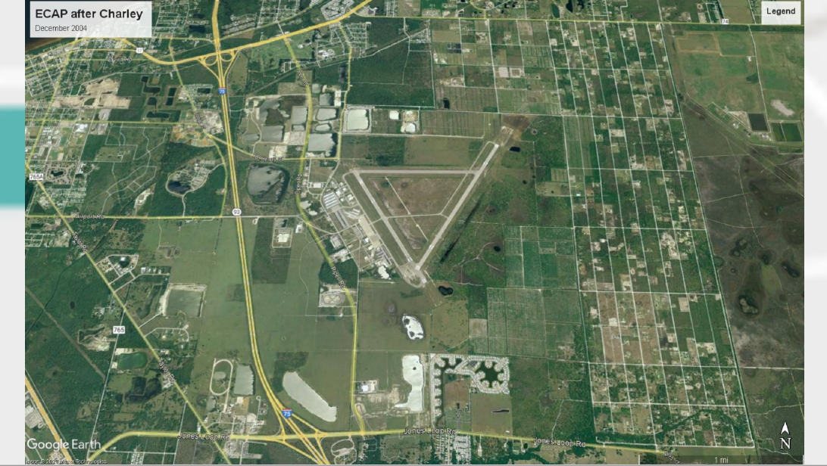

Slide 21
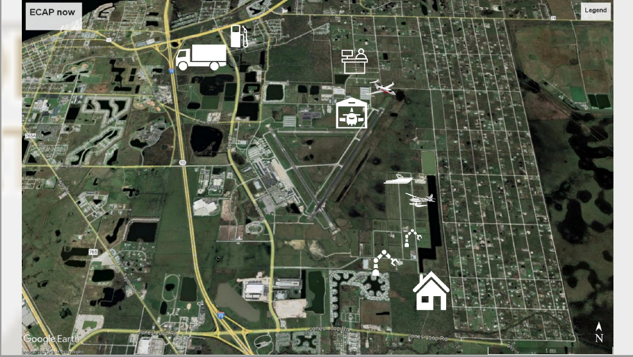

Slide 23
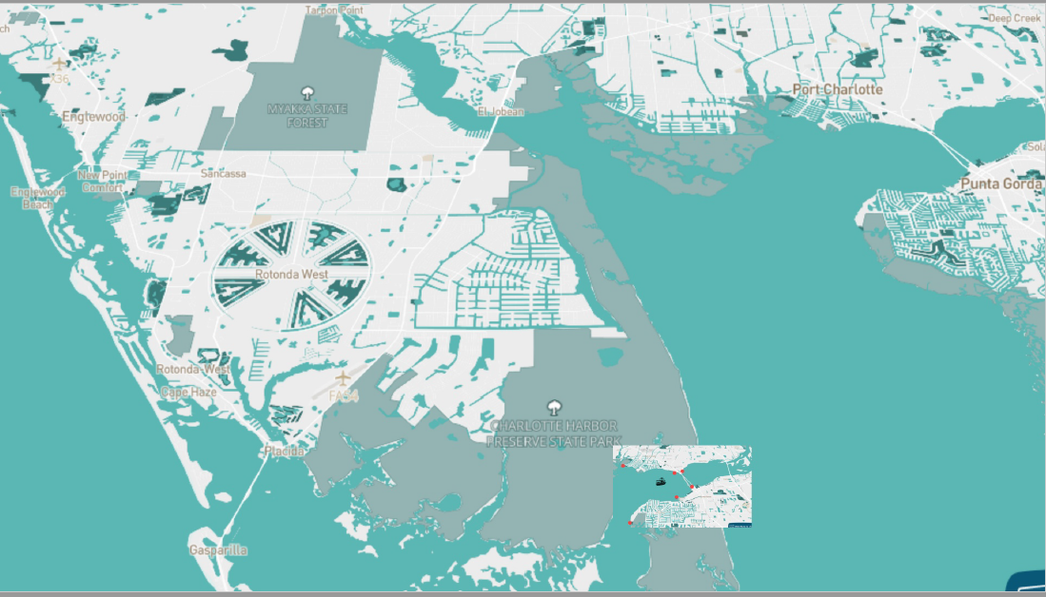

Slide 24
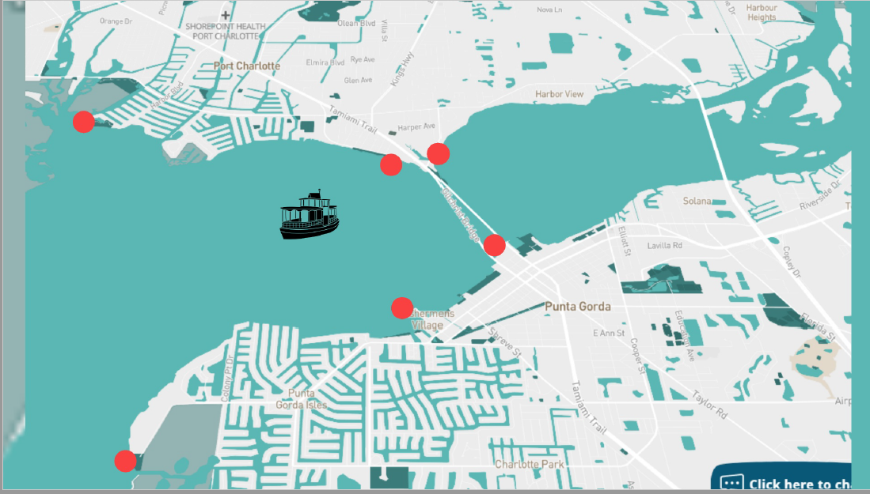

Slide 25
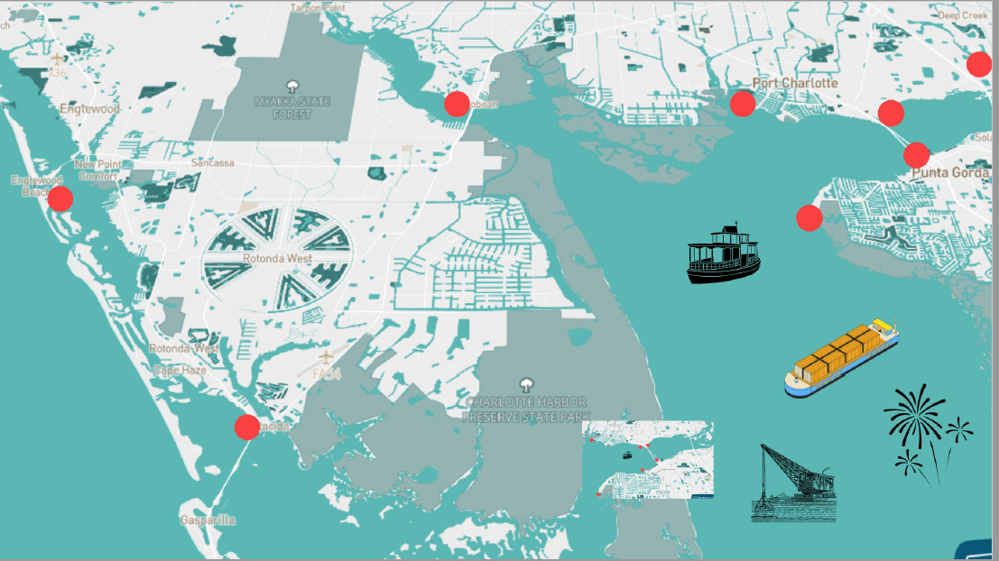

Slide 27
Burnt Store Rd. Corridor

Slide 28
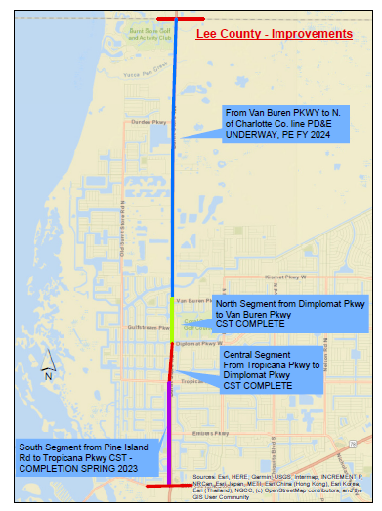

Slide 29
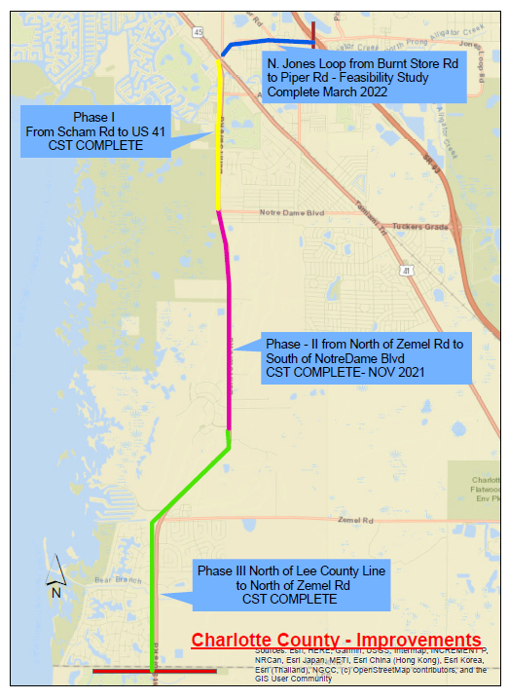

Slide 30
Green Gulf Boulevard Extension

Slide 31
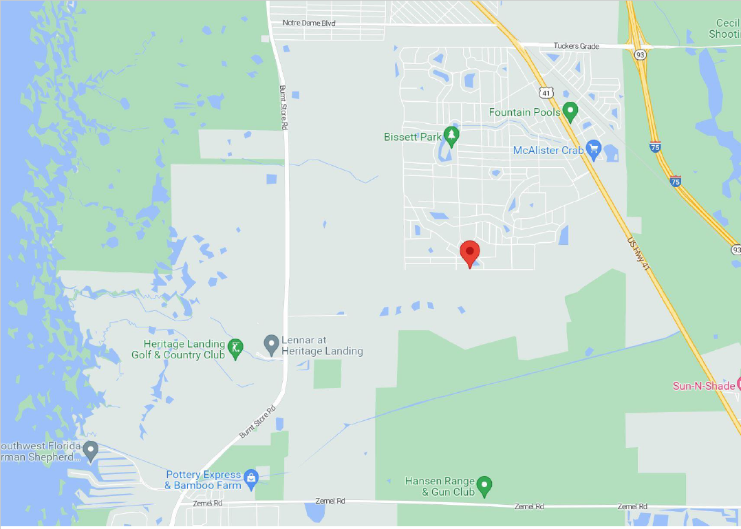

Slide 32
Status of SR 31 Projects

Slide 34
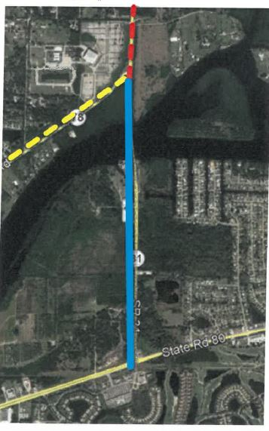
SR 31 from SR 80 to SR 78
PD&E Study started in 2019 and planned completion is early 2024
Alternatives public workshop was held on January 31st
Design to start later this year
Right-of-Way is programmed in FY 2025

Slide 36
SR 31 Bridge Alternatives

Slide 37
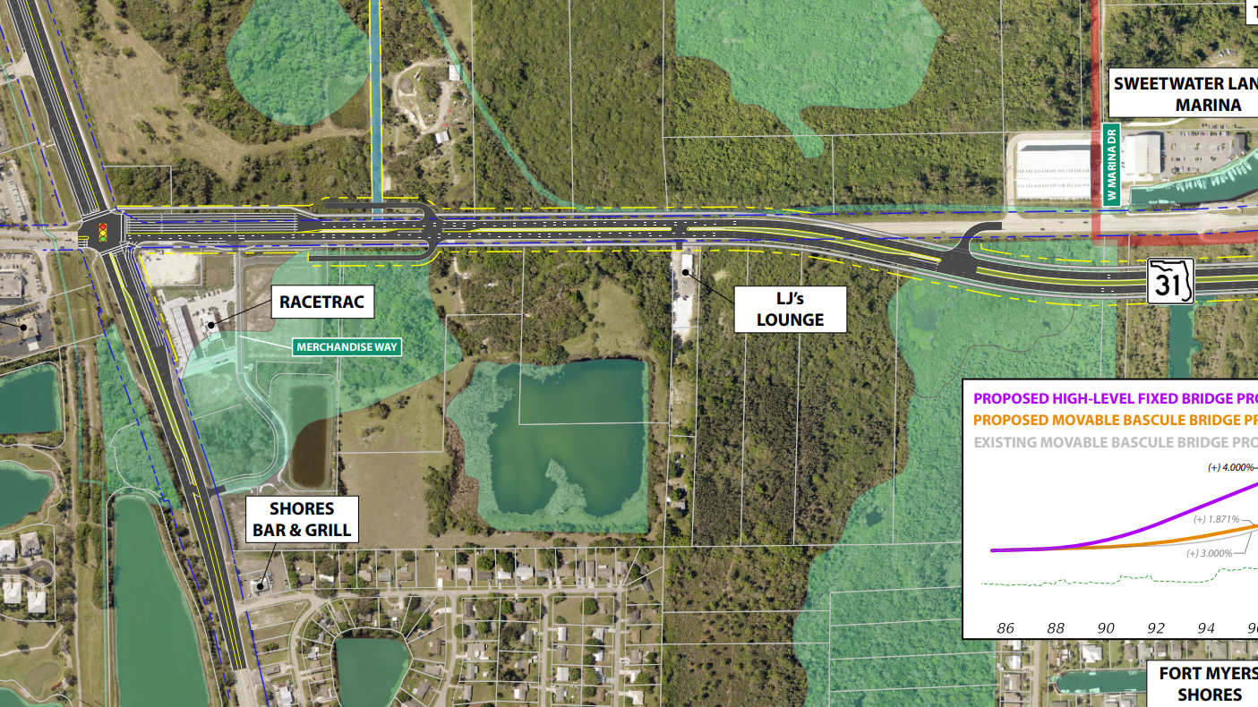
SR 31 South of Bridge At-Grade Alternative

Slide 38
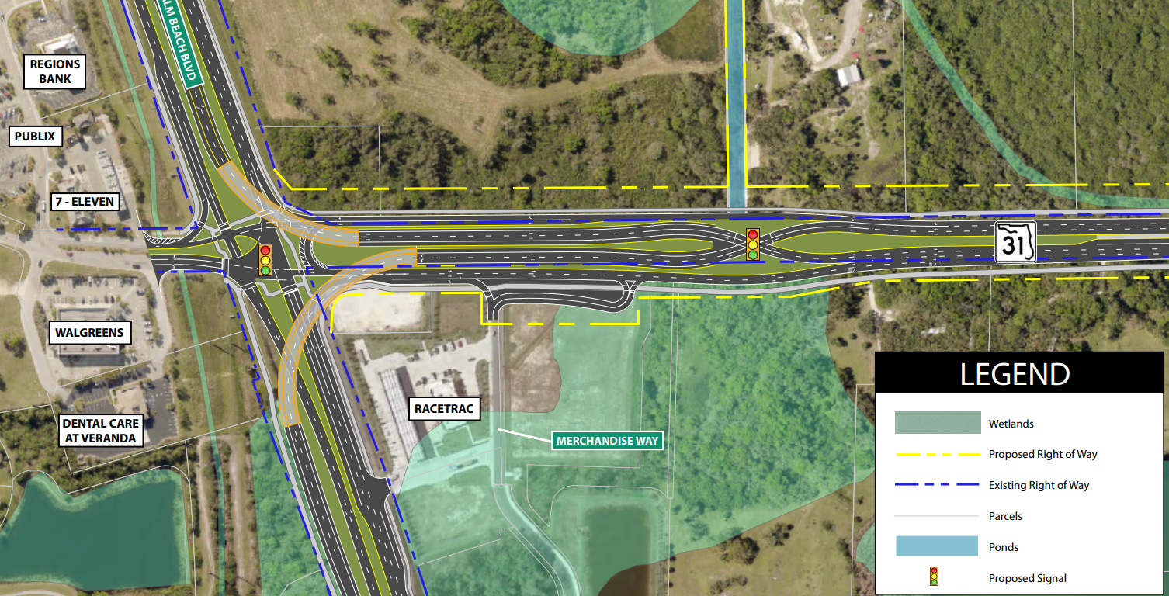
SR 31/SR 80 Flyover Option

Slide 40
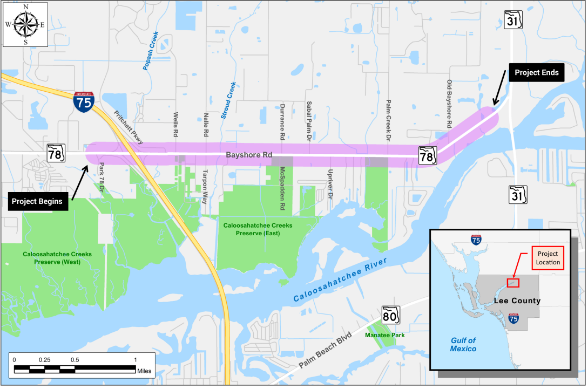
SR 78 from I-75 to SR 31
PD&E started in 2019 and completion is planned for early 2024
Public information meeting is planned for later this year

Slide 41
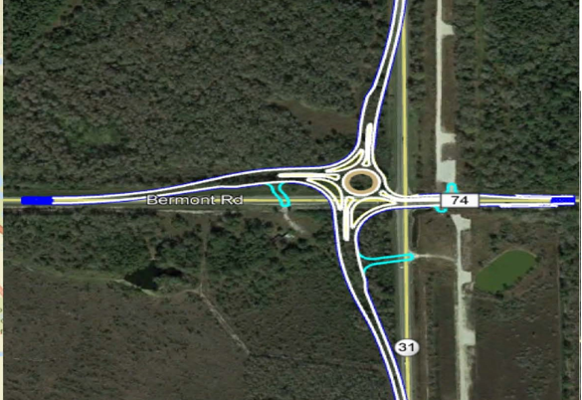
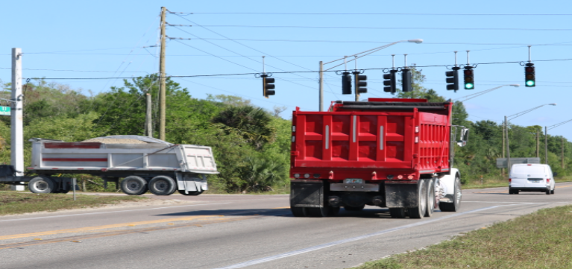
SR 31 and CR 74 Project
Design is underway and completion is planned for May of 2024
Construction start planned for FY 2024
Estimated cost is $9.7 million

Slide 42
I-75 Connect Studies

Slide 64
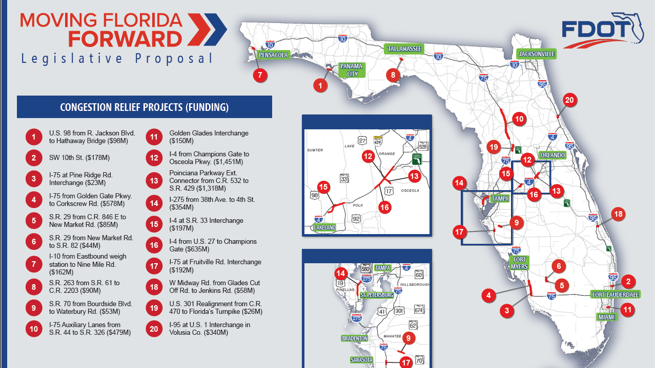

Slide 65
2020 Census and MPO Activities and Schedule

Slide 67
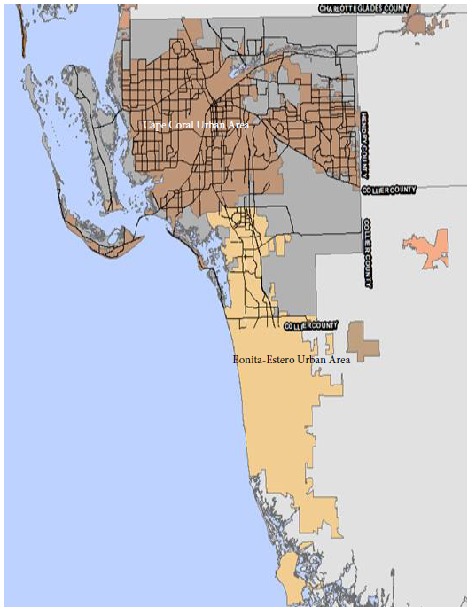

Slide 68
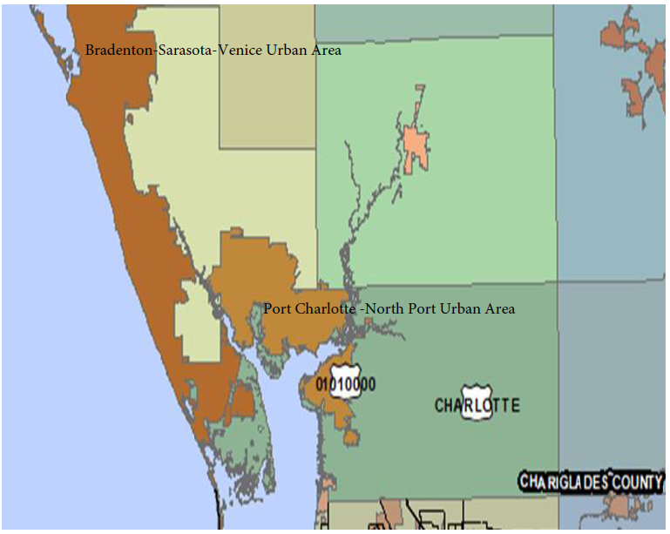

Slide 69
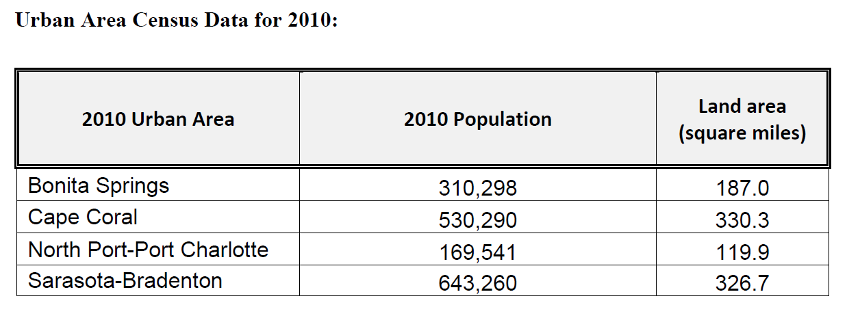
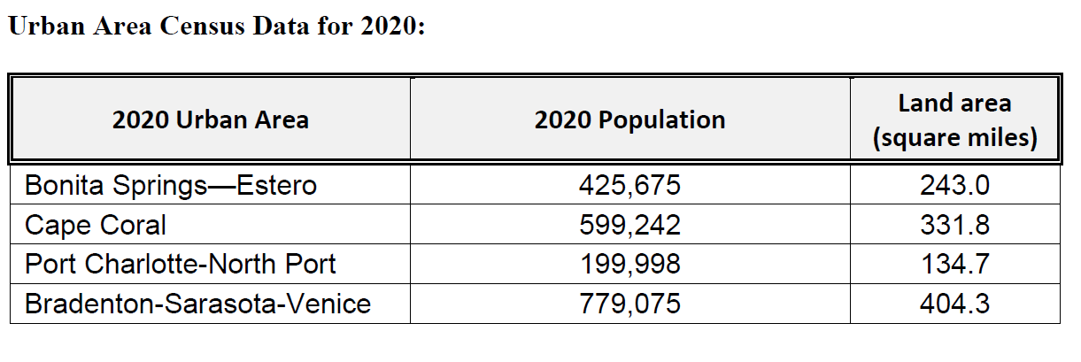

Slide 70
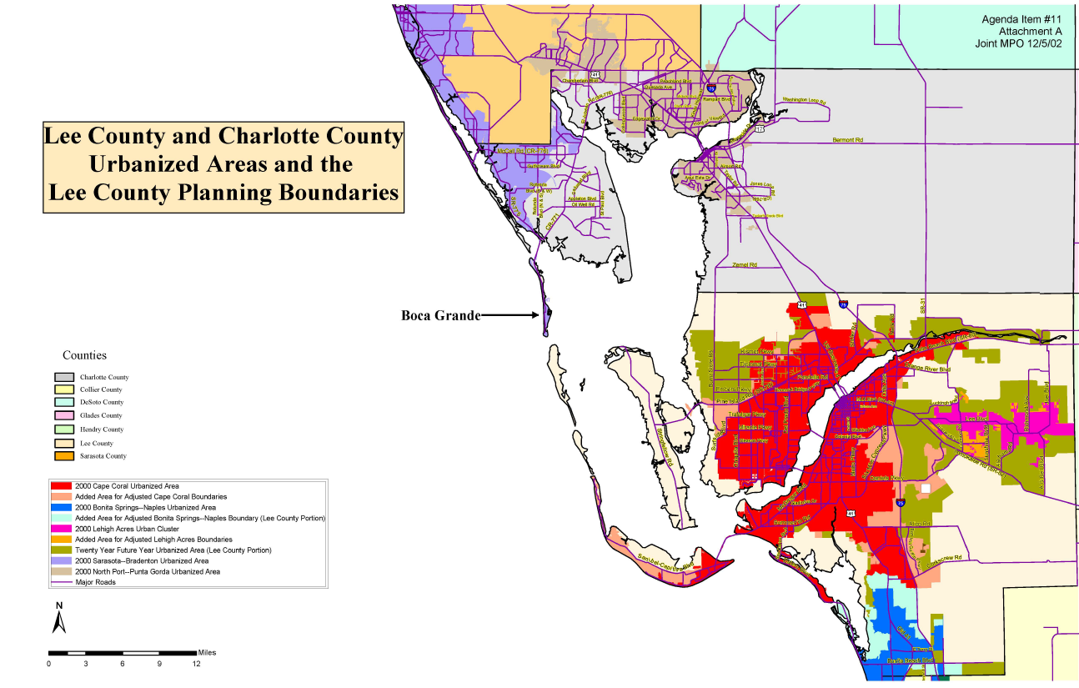

Slide 71
